Slide 1
CUSTOMER BEHAVIOUR ANALYSIS
Customer behaviour analysis looks at how customers make decisions, their product and buying preferences and how they respond to various initiatives, including marketing campaigns, product updates and offers. An analysis can include the psychological factors and social influences that lead to a decision.
Customer behaviour analysis is important because it provides valuable insights for businesses to tailor their offerings, enhance customer experiences and create effective marketing campaigns and product updates. Understanding customer decisions and preferences is essential for long-term success in the marketplace.

Slide 2
Objective:
To analyse customer purchasing behaviour and identify patterns that drive revenue, customer value, and churn risk, enabling data-driven business decisions.
Approach:
The analysis was conducted using Python with a structured analytical framework involving:
Data cleaning and preparation
Exploratory Data Analysis (EDA)
Outlier detection using IQR
Statistical testing (t-test, correlation analysis)
Behavioural segmentation
Predictive churn risk scoring
Business-oriented interpretation of results

Slide 3
Key Analytical Focus Areas:
Spending behaviour analysis
Demographic influence on purchases
Location-based purchasing trends
Gender-based statistical comparison
Purchase distribution and skewness
High-value and risky customer detection
Churn risk modelling
Customer loyalty indicators (previous purchases)

Slide 4
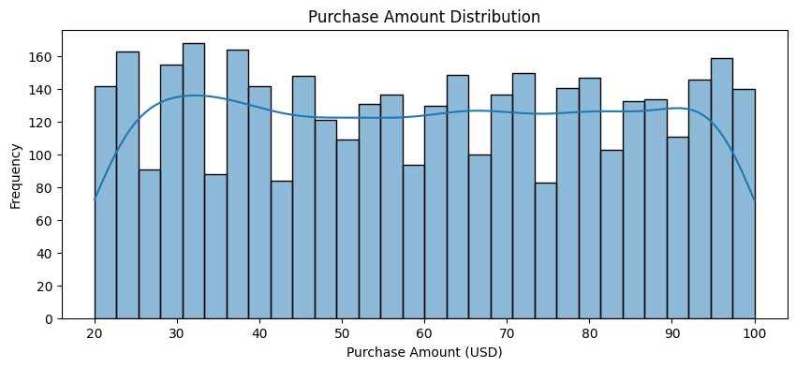

Slide 5
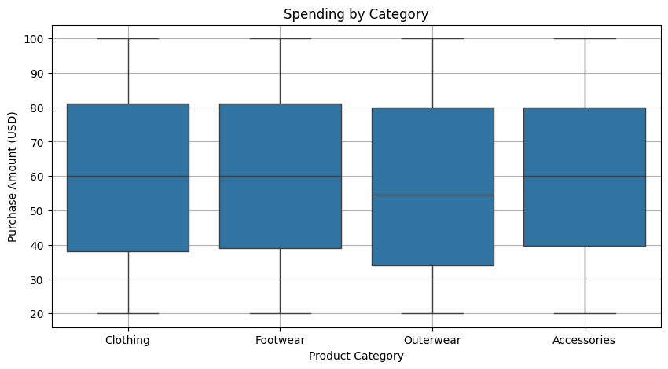

Slide 6
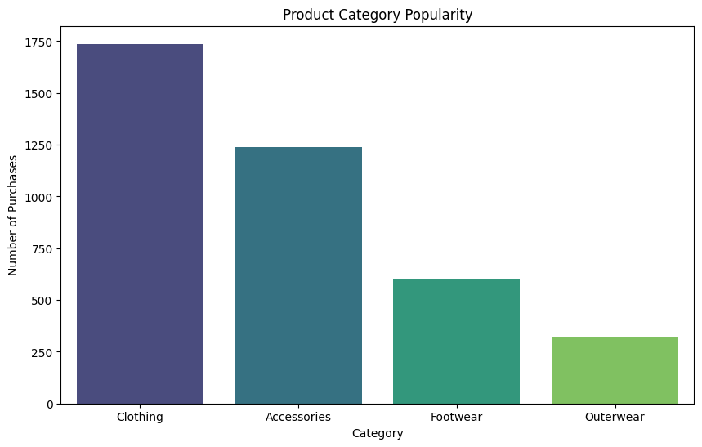

Slide 7
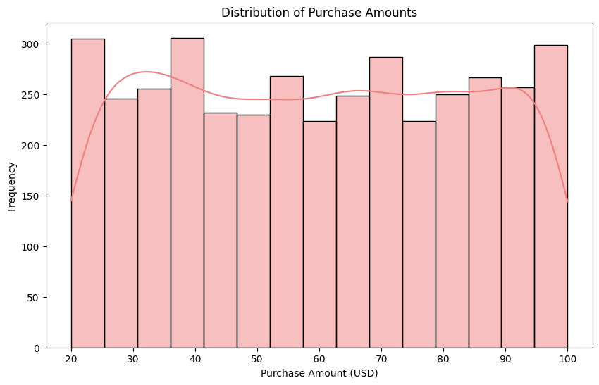

Slide 8
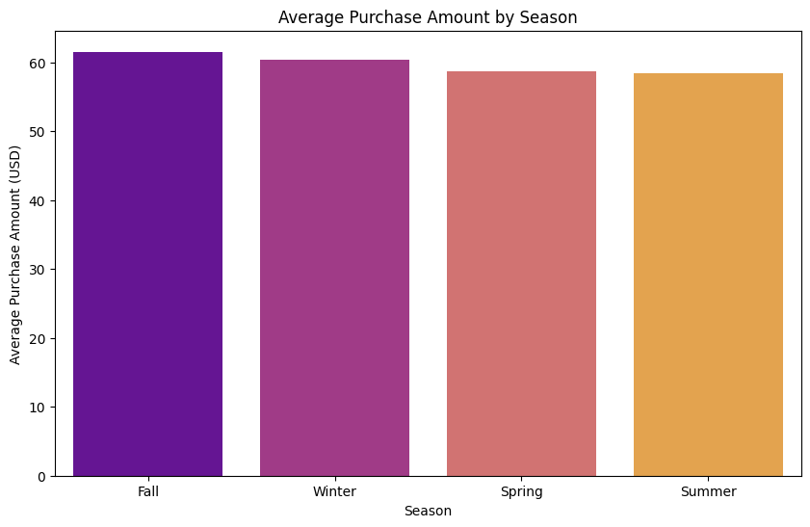

Slide 9
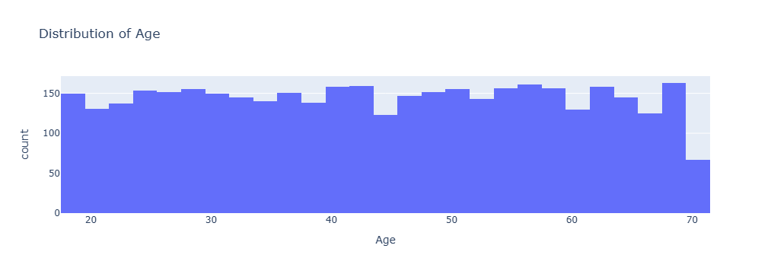

Slide 10
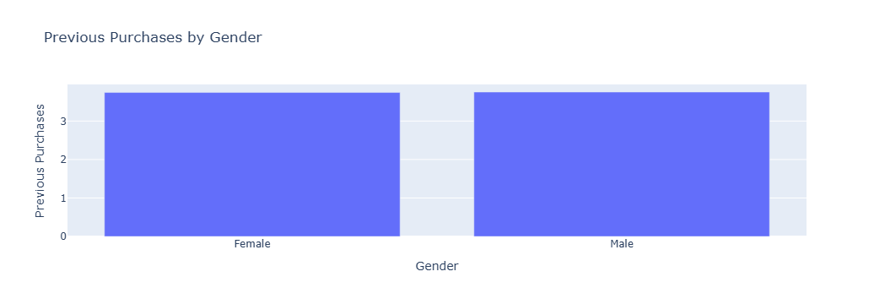
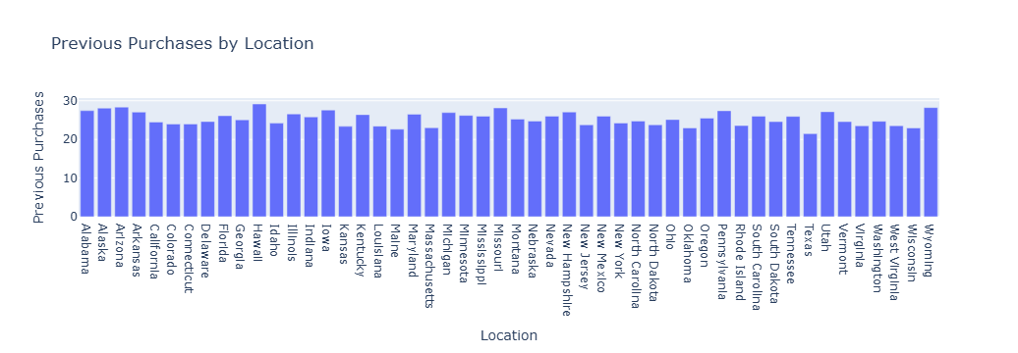

Slide 11
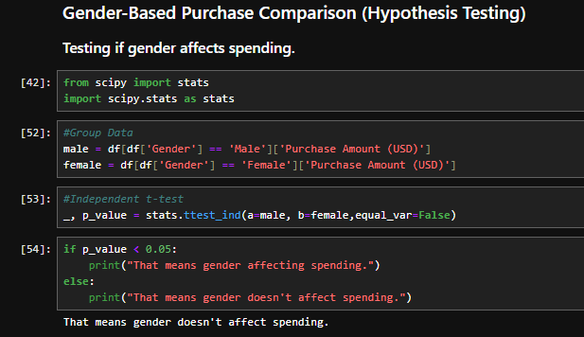
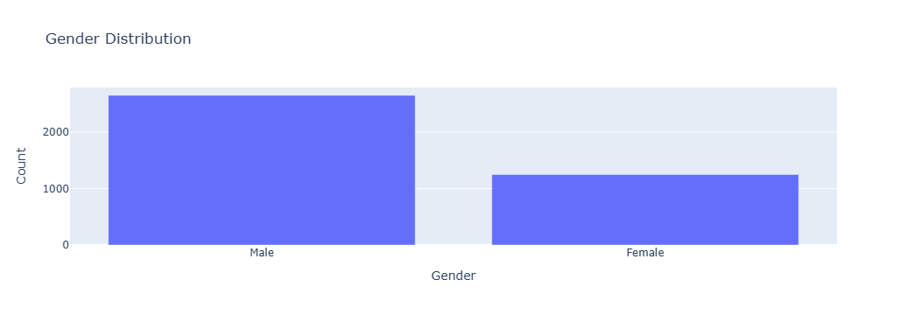

Slide 12
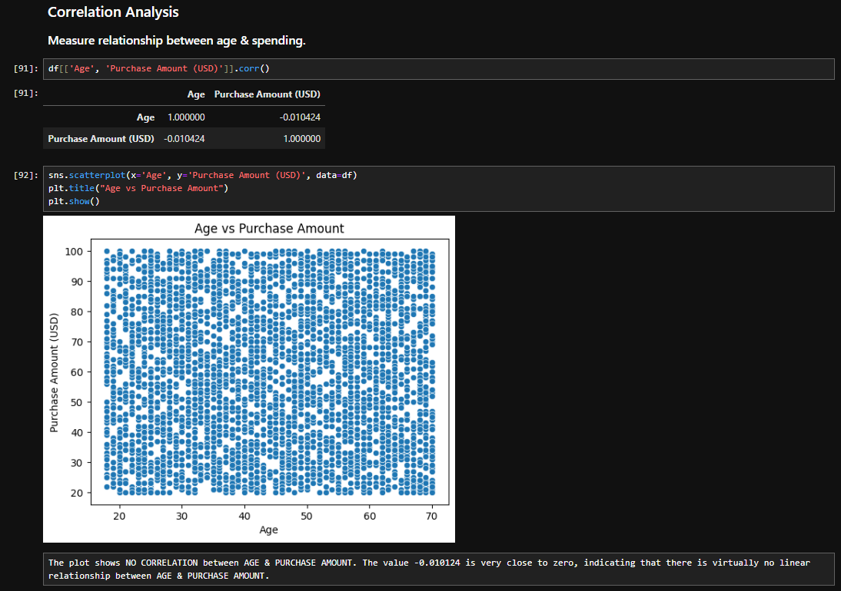

Slide 13
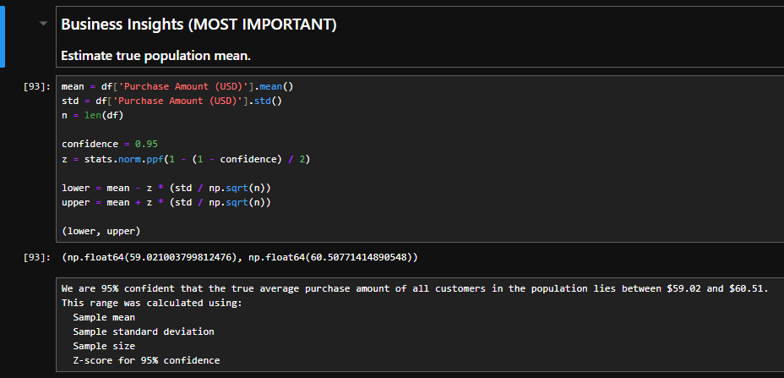

Slide 14
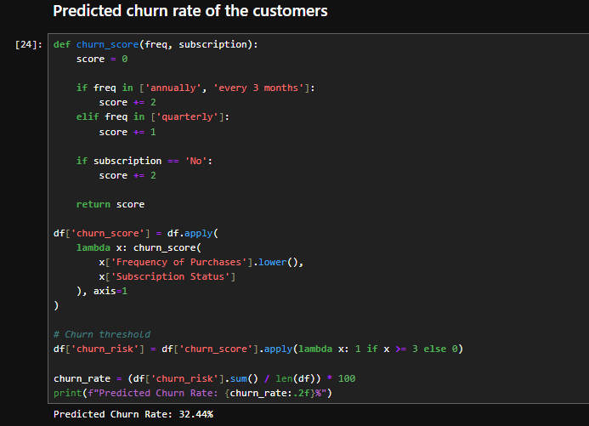

Slide 15
🔍 Key Insights
Spending Patterns: Purchase amounts show variability and skewness, indicating the presence of high-value customers and revenue concentration among specific segments.
Outlier Detection: Identification of high-spending customers using IQR highlights potential premium segments and VIP customer profiles.
Gender Analysis: Statistical testing (independent t-test) indicates whether gender significantly impacts spending behaviour, supporting evidence-based segmentation rather than assumptions.
Age vs Spending Relationship: Correlation and scatter analysis reveal the relationship between customer age and purchase value, supporting targeted demographic strategies.
Geographical Insights: Location-based analysis of previous purchases identifies regions with higher customer engagement and repeat purchase behaviour.
Customer Loyalty: Previous purchase patterns reveal strong indicators of retention potential and customer lifetime value (CLV).
Churn Risk Modelling: A churn scoring model based on behavioural variables (frequency, subscription, engagement) classifies customers into churn-risk categories for proactive retention strategies.
Statistical Confidence: Population mean estimation using confidence intervals provides reliable business forecasting for average customer spending.

Slide 16
📈 Business Impact
This analysis enables the organisation to:
Identify high-value customer segments for premium targeting
Detect churn-prone customers for retention campaigns
Optimise marketing segmentation strategies
Improve customer lifetime value (CLV)
Support data-driven decision making
Enhance revenue forecasting accuracy
Strengthen customer engagement strategies
Enable risk-based customer prioritisation
🎯 Strategic Recommendations
Focus retention strategies on high churn-risk segments identified by churn scoring.
Build loyalty programs for high-value outlier customers to maximise CLV.
Use behavioural segmentation instead of demographic assumptions for marketing.
Prioritise high-performing locations for regional campaign investment.
Apply predictive scoring models for early churn detection.
Design personalised engagement strategies using previous purchase patterns.

Slide 17
🛠 Tools & Technologies
Python
Pandas, NumPy
Matplotlib, Seaborn
Plotly
SciPy (Statistical Testing)
Jupyter Notebook
🧠 Business Value Statement
This project transforms raw customer data into actionable business intelligence by identifying revenue drivers, customer risk factors, and growth opportunities, enabling strategic decision-making, targeted marketing, and long-term customer value optimisation.

Slide 18
THANK YOU.
Author – Soumi Mukherjee
LinkedIn - www.linkedin.com/in/soumimukherjeeofficial

